Slide 1
Enterprise Application Design & Development

Slide 2
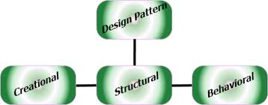
Design Patterns

Slide 3
Creational Patterns
It deal with object creation mechanisms,
Trying to create objects in a manner suitable to the situation.
The basic form of object creation could result in design problems or added complexity to the design.
It solve this problem by somehow controlling this object creation.

Slide 4
Creational Patterns
Abstract Factory
Creates an instance of several families of classes
Builder
Separates object construction from its representation
Factory Method
Creates an instance of several derived classes
Prototype
A fully initialized instance to be copied or cloned
Singleton
A class of which only a single instance can exist
Notes:
Abstract Factory => Provide an interface for creating families of related or dependent objects without specifying their concrete classes.
Builder => Separate the construction of a complex object from its representation so that the same construction process can create different representations.
Factory Method => Define an interface for creating an object, but let subclasses decide which class to instantiate. Factory Method lets a class defer instantiation to subclasses.
Prototype => Specify the kind of objects to create using a prototypical instance, and create new objects by copying this prototype.
Singleton => Ensure a class has only one instance and provide a global point of access to it.

Slide 5
Abstract Factory
Provide an interface for creating families of related or dependent objects without specifying their concrete classes.
Notes:
Abstract Factory => Provide an interface for creating families of related or dependent objects without specifying their concrete classes.
Builder => Separate the construction of a complex object from its representation so that the same construction process can create different representations.
Factory Method => Define an interface for creating an object, but let subclasses decide which class to instantiate. Factory Method lets a class defer instantiation to subclasses.
Prototype => Specify the kind of objects to create using a prototypical instance, and create new objects by copying this prototype.
Singleton => Ensure a class has only one instance and provide a global point of access to it.

Slide 6
Builder
Separate the construction of a complex object from its representation so that the same construction process can create different representations.
Notes:
Abstract Factory => Provide an interface for creating families of related or dependent objects without specifying their concrete classes.
Builder => Separate the construction of a complex object from its representation so that the same construction process can create different representations.
Factory Method => Define an interface for creating an object, but let subclasses decide which class to instantiate. Factory Method lets a class defer instantiation to subclasses.
Prototype => Specify the kind of objects to create using a prototypical instance, and create new objects by copying this prototype.
Singleton => Ensure a class has only one instance and provide a global point of access to it.

Slide 7
Factory Method
Define an interface for creating an object, but let subclasses decide which class to instantiate. Factory Method lets a class defer instantiation to subclasses.
Notes:
Abstract Factory => Provide an interface for creating families of related or dependent objects without specifying their concrete classes.
Builder => Separate the construction of a complex object from its representation so that the same construction process can create different representations.
Factory Method => Define an interface for creating an object, but let subclasses decide which class to instantiate. Factory Method lets a class defer instantiation to subclasses.
Prototype => Specify the kind of objects to create using a prototypical instance, and create new objects by copying this prototype.
Singleton => Ensure a class has only one instance and provide a global point of access to it.

Slide 8
Prototype
Specify the kind of objects to create using a prototypical instance, and create new objects by copying this prototype.
Notes:
Abstract Factory => Provide an interface for creating families of related or dependent objects without specifying their concrete classes.
Builder => Separate the construction of a complex object from its representation so that the same construction process can create different representations.
Factory Method => Define an interface for creating an object, but let subclasses decide which class to instantiate. Factory Method lets a class defer instantiation to subclasses.
Prototype => Specify the kind of objects to create using a prototypical instance, and create new objects by copying this prototype.
Singleton => Ensure a class has only one instance and provide a global point of access to it.

Slide 9
Singleton
Ensure a class has only one instance and provide a global point of access to it.
Notes:
Abstract Factory => Provide an interface for creating families of related or dependent objects without specifying their concrete classes.
Builder => Separate the construction of a complex object from its representation so that the same construction process can create different representations.
Factory Method => Define an interface for creating an object, but let subclasses decide which class to instantiate. Factory Method lets a class defer instantiation to subclasses.
Prototype => Specify the kind of objects to create using a prototypical instance, and create new objects by copying this prototype.
Singleton => Ensure a class has only one instance and provide a global point of access to it.

Slide 10
Structural Patterns
Adapter => Match interfaces of different classes
Bridge => Separates an object’s interface from its implementation
Composite => A tree structure of simple and composite objects
Decorator => Add responsibilities to objects dynamically
Facade => A single class that represents an entire subsystem
Flyweight => A fine-grained instance used for efficient sharing
Proxy => An object representing another object

Slide 11
Adapter
Convert the interface of a class into another interface clients expect.
Adapter lets classes work together that couldn't otherwise because of incompatible interfaces.
Wrap an existing class with a new interface.
Impedance (obstacle) match an old component to a new system
It is like the problem of inserting a new three-prong electrical plug in an old two-prong wall outlet – some kind of adapter or intermediary is necessary.

Slide 12
Check list
Identify the players: the component(s) that want to be accommodated (i.e. the client), and the component that needs to adapt (i.e. the adaptee).
Identify the interface that the client requires.
Design a "wrapper" class that can "impedance match" the adaptee to the client.
The adapter/wrapper class "has a" instance of the adaptee class.
The adapter/wrapper class "maps" the client interface to the adaptee interface.
The client uses (is coupled to) the new interface

Slide 13
Rules of thumb
We discus in Last

Slide 14
Bridge
Decouple an abstraction from its implementation so that the two can vary independently.
Publish interface in an inheritance hierarchy, and bury implementation in its own inheritance hierarchy.
Beyond encapsulation, to insulation
Notes:
"Hardening of the software arteries" has occurred by using subclassing of an abstract base class to provide alternative implementations. This locks in compile-time binding between interface and implementation. The abstraction and implementation cannot be independently extended or composed.

Slide 15
Use the Bridge pattern when
When we want run-time binding of the implementation,
When we have a proliferation of classes resulting from a coupled interface and numerous implementations,
When we want to share an implementation among multiple objects,
When we need to map orthogonal class hierarchies.

Slide 16
Consequences include
decoupling the object's interface,
improved extensibility (you can extend (i.e. subclass) the abstraction and implementation hierarchies independently),
hiding details from clients.

Slide 17
Check list
Decide if two orthogonal dimensions exist in the domain. These independent concepts could be: abstraction/platform, or domain/infrastructure, or front-end/back-end, or interface/implementation.
Design the separation of concerns: what does the client want, and what do the platforms provide.
Design a platform-oriented interface that is minimal, necessary, and sufficient. Its goal is to decouple the abstraction from the platform.
Define a derived class of that interface for each platform.
Create the abstraction base class that "has a" platform object and delegates the platform-oriented functionality to it.
Define specializations of the abstraction class if desired.

Slide 18
Composite
Compose objects into tree structures to represent whole-part hierarchies.
Composite lets clients treat individual objects and compositions of objects uniformly.
Recursive composition
"Directories contain entries, each of which could be a directory."
1-to-many "has a" up the "is a" hierarchy
Notes:
Application needs to manipulate a hierarchical collection of "primitive" and "composite" objects. Processing of a primitive object is handled one way, and processing of a composite object is handled differently. Having to query the "type" of each object before attempting to process it is not desirable

Slide 19
Check list
Ensure that your problem is about representing "whole-part" hierarchical relationships.
Consider the heuristic, "Containers that contain containees, each of which could be a container." For example, "Assemblies that contain components, each of which could be an assembly." Divide your domain concepts into container classes, and containee classes.
Create a "lowest common denominator" interface that makes your containers and containees interchangeable. It should specify the behavior that needs to be exercised uniformly across all containee and container objects.
All container and containee classes declare an "is a" relationship to the interface.
All container classes declare a one-to-many "has a" relationship to the interface.
Container classes leverage polymorphism to delegate to their containee objects.
Child management methods [e.g. addChild(), removeChild()] should normally be defined in the Composite class. Unfortunately, the desire to treat Leaf and Composite objects uniformly may require that these methods be promoted to the abstract Component class. See the Gang of Four for a discussion of these "safety" versus "transparency" trade-offs.

Slide 20
Decorator
Attach additional responsibilities to an object dynamically. Decorators provide a flexible alternative to subclassing for extending functionality.
Client-specified embellishment of a core object by recursively wrapping it.
Wrapping a gift, putting it in a box, and wrapping the box.
Notes:
You want to add behavior or state to individual objects at run-time. Inheritance is not feasible because it is static and applies to an entire class.

Slide 21
Check list
Ensure the context is: a single core (or non-optional) component, several optional embellishments or wrappers, and an interface that is common to all.
Create a "Lowest Common Denominator" interface that makes all classes interchangeable.
Create a second level base class (Decorator) to support the optional wrapper classes.
The Core class and Decorator class inherit from the LCD interface.
The Decorator class declares a composition relationship to the LCD interface, and this data member is initialized in its constructor.
The Decorator class delegates to the LCD object.
Define a Decorator derived class for each optional embellishment.
Decorator derived classes implement their wrapper functionality - and - delegate to the Decorator base class.
The client configures the type and ordering of Core and Decorator objects.

Slide 22
Facade
Provide a unified interface to a set of interfaces in a subsystem. Facade defines a higher-level interface that makes the subsystem easier to use.
Wrap a complicated subsystem with a simpler interface.
Notes:
A segment of the client community needs a simplified interface to the overall functionality of a complex subsystem.
Facade discusses encapsulating a complex subsystem within a single interface object. This reduces the learning curve necessary to successfully leverage the subsystem. It also promotes decoupling the subsystem from its potentially many clients. On the other hand, if the Facade is the only access point for the subsystem, it will limit the features and flexibility that "power users" may need.
The Facade object should be a fairly simple advocate or facilitator. It should not become an all-knowing oracle or "god" object.

Slide 23
Check list
Identify a simpler, unified interface for the subsystem or component.
Design a 'wrapper' class that encapsulates the subsystem.
The facade/wrapper captures the complexity and collaborations of the component, and delegates to the appropriate methods.
The client uses (is coupled to) the Facade only.
Consider whether additional Facades would add value.

Slide 24
Flyweight
Use sharing to support large numbers of fine-grained objects efficiently.
The Motif GUI strategy of replacing heavy-weight widgets with light-weight gadgets.
Notes:
Designing objects down to the lowest levels of system "granularity" provides optimal flexibility, but can be unacceptably expensive in terms of performance and memory usage.

Slide 25
Check list
Ensure that object overhead is an issue needing attention, and, the client of the class is able and willing to absorb responsibility realignment.
Divide the target class's state into: shareable (intrinsic) state, and non-shareable (extrinsic) state.
Remove the non-shareable state from the class attributes, and add it the calling argument list of affected methods.
Create a Factory that can cache and reuse existing class instances.
The client must use the Factory instead of the new operator to request objects.
The client (or a third party) must look-up or compute the non-shareable state, and supply that state to class methods.

Slide 26
Private Class Data
Control write access to class attributes
Separate data from methods that use it
Encapsulate class data initialization
Providing new type of final - final after constructor
Notes:
A class may expose its attributes (class variables) to manipulation when manipulation is no longer desirable, e.g. after construction. Using the private class data design pattern prevents that undesirable manipulation.
A class may have one-time mutable attributes that cannot be declared final. Using this design pattern allows one-time setting of those class attributes.
The motivation for this design pattern comes from the design goal of protecting class state by minimizing the visibility of its attributes (data).
Discussion
The private class data design pattern seeks to reduce exposure of attributes by limiting their visibility.
It reduces the number of class attributes by encapsulating them in single Data object. It allows the class designer to remove write privilege of attributes that are intended to be set only during construction, even from methods of the target class.

Slide 27
Check list
Create data class. Move to data class all attributes that need hiding.
Create in main class instance of data class.
Main class must initialize data class through the data class's constructor.
Expose each attribute (variable or property) of data class through a getter.
Expose each attribute that will change in further through a setter.

Slide 28
Proxy Design Pattern
Provide a surrogate or placeholder for another object to control access to it.
Use an extra level of indirection to support distributed, controlled, or intelligent access.
Add a wrapper and delegation to protect the real component from undue complexity.
Notes:
You need to support resource-hungry objects, and you do not want to instantiate such objects unless and until they are actually requested by the client.
Discussion
Design a surrogate, or proxy, object that: instantiates the real object the first time the client makes a request of the proxy, remembers the identity of this real object, and forwards the instigating request to this real object. Then all subsequent requests are simply forwarded directly to the encapsulated real object.
There are four common situations in which the Proxy pattern is applicable.
A virtual proxy is a placeholder for "expensive to create" objects. The real object is only created when a client first requests/accesses the object.
A remote proxy provides a local representative for an object that resides in a different address space. This is what the "stub" code in RPC and CORBA provides.
A protective proxy controls access to a sensitive master object. The "surrogate" object checks that the caller has the access permissions required prior to forwarding the request.
A smart proxy interposes additional actions when an object is accessed. Typical uses include:
Counting the number of references to the real object so that it can be freed automatically when there are no more references (aka smart pointer),
Loading a persistent object into memory when it's first referenced,
Checking that the real object is locked before it is accessed to ensure that no other object can change it.

Slide 29
Check list
Identify the leverage or "aspect" that is best implemented as a wrapper or surrogate.
Define an interface that will make the proxy and the original component interchangeable.
Consider defining a Factory that can encapsulate the decision of whether a proxy or original object is desirable.
The wrapper class holds a pointer to the real class and implements the interface.
The pointer may be initialized at construction, or on first use.
Each wrapper method contributes its leverage, and delegates to the wrappee object.

Slide 30
Behavioral Patterns
Behavioral design patterns are design patterns that identify common communication patterns between objects and realize these patterns.
By doing so, these patterns increase flexibility in carrying out this communication.

Slide 31
Behavioral Patterns
Chain of responsibility => A way of passing a request between a chain of objects
Command => Encapsulate a command request as an object
Interpreter => A way to include language elements in a program
Iterator => Sequentially access the elements of a collection
Mediator => Defines simplified communication between classes
Memento => Capture and restore an object's internal state
Null Object => Designed to act as a default value of an object
Observer => A way of notifying change to a number of classes
State => Alter an object's behavior when its state changes
Strategy => Encapsulates an algorithm inside a class
Template method => Defer the exact steps of an algorithm to a subclass
Visitor => Defines a new operation to a class without change

Slide 32
Chain of Responsibility
Avoid coupling the sender of a request to its receiver by giving more than one object a chance to handle the request. Chain the receiving objects and pass the request along the chain until an object handles it.
Launch-and-leave requests with a single processing pipeline that contains many possible handlers.
An object-oriented linked list with recursive traversal.
Notes:
There is a potentially variable number of "handler" or "processing element" or "node" objects, and a stream of requests that must be handled. Need to efficiently process the requests without hard-wiring handler relationships and precedence, or request-to-handler mappings.

Slide 33
Check list
The base class maintains a "next" pointer.
Each derived class implements its contribution for handling the request.
If the request needs to be "passed on", then the derived class "calls back" to the base class, which delegates to the "next" pointer.
The client (or some third party) creates and links the chain (which may include a link from the last node to the root node).
The client "launches and leaves" each request with the root of the chain.
Recursive delegation produces the illusion of magic.

Slide 34
Command
Encapsulate a request as an object, thereby letting you parameterize clients with different requests, queue or log requests, and support undoable operations.
Promote "invocation of a method on an object" to full object status
An object-oriented callback
Notes:
Need to issue requests to objects without knowing anything about the operation being requested or the receiver of the request.

Slide 35
Check list
Define a Command interface with a method signature like execute().
Create one or more derived classes that encapsulate some subset of the following: a "receiver" object, the method to invoke, the arguments to pass.
Instantiate a Command object for each deferred execution request.
Pass the Command object from the creator (aka sender) to the invoker (aka receiver).
The invoker decides when to execute().

Slide 36
Interpreter
Given a language, define a representation for its grammar along with an interpreter that uses the representation to interpret sentences in the language.
Map a domain to a language, the language to a grammar, and the grammar to a hierarchical object-oriented design.
Notes:
A class of problems occurs repeatedly in a well-defined and well-understood domain. If the domain were characterized with a "language", then problems could be easily solved with an interpretation "engine".

Slide 37
Check list
Decide if a "little language" offers a justifiable return on investment.
Define a grammar for the language.
Map each production in the grammar to a class.
Organize the suite of classes into the structure of the Composite pattern.
Define an interpret(Context) method in the Composite hierarchy.
The Context object encapsulates the current state of the input and output as the former is parsed and the latter is accumulated. It is manipulated by each grammar class as the "interpreting" process transforms the input into the output.

Slide 38
Iterator
Provide a way to access the elements of an aggregate object sequentially without exposing its underlying representation.
The C++ and Java standard library abstraction that makes it possible to decouple collection classes and algorithms.
Promote to "full object status" the traversal of a collection.
Polymorphic traversal
Notes:
Need to "abstract" the traversal of wildly different data structures so that algorithms can be defined that are capable of interfacing with each transparently.

Slide 39
Check list
Add a create_iterator() method to the "collection" class, and grant the "iterator" class privileged access.
Design an "iterator" class that can encapsulate traversal of the "collection" class.
Clients ask the collection object to create an iterator object.
Clients use the first(), is_done(), next(), and current_item() protocol to access the elements of the collection class.

Slide 40
Mediator
Define an object that encapsulates how a set of objects interact. Mediator promotes loose coupling by keeping objects from referring to each other explicitly, and it lets you vary their interaction independently.
Design an intermediary to decouple many peers.
Promote the many-to-many relationships between interacting peers to "full object status".
Notes:
We want to design reusable components, but dependencies between the potentially reusable pieces demonstrates the "spaghetti code" phenomenon (trying to scoop a single serving results in an "all or nothing clump").

Slide 41
Check list
Identify a collection of interacting objects that would benefit from mutual decoupling.
Encapsulate those interactions in the abstraction of a new class.
Create an instance of that new class and rework all "peer" objects to interact with the Mediator only.
Balance the principle of decoupling with the principle of distributing responsibility evenly.
Be careful not to create a "controller" or "god" object.

Slide 42
Memento
Without violating encapsulation, capture and externalize an object's internal state so that the object can be returned to this state later.
A magic cookie that encapsulates a "check point" capability.
Promote undo or rollback to full object status.
Notes:
Need to restore an object back to its previous state (e.g. "undo" or "rollback" operations).

Slide 43
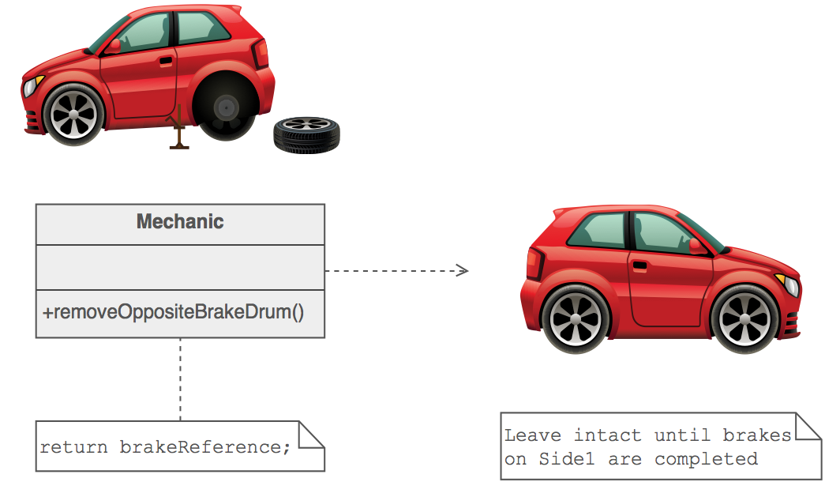

Slide 44
Check list
Identify the roles of “caretaker” and “originator”.
Create a Memento class and declare the originator a friend.
Caretaker knows when to "check point" the originator.
Originator creates a Memento and copies its state to that Memento.
Caretaker holds on to (but cannot peek into) the Memento.
Caretaker knows when to "roll back" the originator.
Originator reinstates itself using the saved state in the Memento.

Slide 45
Null Object (Not much more relable)
The intent of a Null Object is to encapsulate the absence of an object by providing a substitutable alternative that offers suitable default do nothing behavior. In short, a design where "nothing will come of nothing"
Use the Null Object pattern when
An object requires a collaborator. The Null Object pattern does not introduce this collaboration--it makes use of a collaboration that already exists
Some collaborator instances should do nothing
You want to abstract the handling of null away from the client
Notes:
Given that an object reference may be optionally null, and that the result of a null check is to do nothing or use some default value, how can the absence of an object — the presence of a null reference — be treated transparently?

Slide 46
Observer
Define a one-to-many dependency between objects so that when one object changes state, all its dependents are notified and updated automatically.
Encapsulate the core (or common or engine) components in a Subject abstraction, and the variable (or optional or user interface) components in an Observer hierarchy.
The "View" part of Model-View-Controller.
Notes:
A large monolithic design does not scale well as new graphing or monitoring requirements are levied.

Slide 47
Check list
Differentiate between the core (or independent) functionality and the optional (or dependent) functionality.
Model the independent functionality with a "subject" abstraction.
Model the dependent functionality with an "observer" hierarchy.
The Subject is coupled only to the Observer base class.
The client configures the number and type of Observers.
Observers register themselves with the Subject.
The Subject broadcasts events to all registered Observers.
The Subject may "push" information at the Observers, or, the Observers may "pull" the information they need from the Subject.

Slide 48
State
Allow an object to alter its behavior when its internal state changes. The object will appear to change its class.
An object-oriented state machine
wrapper + polymorphic wrappee + collaboration
Notes:
A monolithic object's behavior is a function of its state, and it must change its behavior at run-time depending on that state. Or, an application is characterixed by large and numerous case statements that vector flow of control based on the state of the application.

Slide 49
Check list
Identify an existing class, or create a new class, that will serve as the "state machine" from the client's perspective. That class is the "wrapper" class.
Create a State base class that replicates the methods of the state machine interface. Each method takes one additional parameter: an instance of the wrapper class. The State base class specifies any useful "default" behavior.
Create a State derived class for each domain state. These derived classes only override the methods they need to override.
The wrapper class maintains a "current" State object.
All client requests to the wrapper class are simply delegated to the current State object, and the wrapper object's this pointer is passed.
The State methods change the "current" state in the wrapper object as appropriate.

Slide 50
Strategy
Define a family of algorithms, encapsulate each one, and make them interchangeable. Strategy lets the algorithm vary independently from the clients that use it.
Capture the abstraction in an interface, bury implementation details in derived classes.
Notes:
One of the dominant strategies of object-oriented design is the "open-closed principle".

Slide 51
Check list
Identify an algorithm (i.e. a behavior) that the client would prefer to access through a "flex point".
Specify the signature for that algorithm in an interface.
Bury the alternative implementation details in derived classes.
Clients of the algorithm couple themselves to the interface.

Slide 52
Template Method
Define the skeleton of an algorithm in an operation, deferring some steps to client subclasses. Template Method lets subclasses redefine certain steps of an algorithm without changing the algorithm's structure.
Base class declares algorithm 'placeholders', and derived classes implement the placeholders.
Notes:
Two different components have significant similarities, but demonstrate no reuse of common interface or implementation. If a change common to both components becomes necessary, duplicate effort must be expended.

Slide 53
Check list
Examine the algorithm, and decide which steps are standard and which steps are peculiar to each of the current classes.
Define a new abstract base class to host the "don't call us, we'll call you" framework.
Move the shell of the algorithm (now called the "template method") and the definition of all standard steps to the new base class.
Define a placeholder or "hook" method in the base class for each step that requires many different implementations. This method can host a default implementation – or – it can be defined as abstract (Java) or pure virtual (C++).
Invoke the hook method(s) from the template method.
Each of the existing classes declares an "is-a" relationship to the new abstract base class.
Remove from the existing classes all the implementation details that have been moved to the base class.
The only details that will remain in the existing classes will be the implementation details peculiar to each derived class.

Slide 54
Visitor
Represent an operation to be performed on the elements of an object structure. Visitor lets you define a new operation without changing the classes of the elements on which it operates.
The classic technique for recovering lost type information.
Do the right thing based on the type of two objects.
Double dispatch
Notes:
Many distinct and unrelated operations need to be performed on node objects in a heterogeneous aggregate structure. You want to avoid "polluting" the node classes with these operations. And, you don't want to have to query the type of each node and cast the pointer to the correct type before performing the desired operation.

Slide 55
Check list
Confirm that the current hierarchy (known as the Element hierarchy) will be fairly stable and that the public interface of these classes is sufficient for the access the Visitor classes will require. If these conditions are not met, then the Visitor pattern is not a good match.
Create a Visitor base class with a visit(ElementXxx) method for each Element derived type.
Add an accept(Visitor) method to the Element hierarchy. The implementation in each Element derived class is always the same – accept( Visitor v ) { v.visit( this ); }. Because of cyclic dependencies, the declaration of the Element and Visitor classes will need to be interleaved.
The Element hierarchy is coupled only to the Visitor base class, but the Visitor hierarchy is coupled to each Element derived class. If the stability of the Element hierarchy is low, and the stability of the Visitor hierarchy is high; consider swapping the 'roles' of the two hierarchies.
Create a Visitor derived class for each "operation" to be performed on Element objects. visit() implementations will rely on the Element's public interface.
The client creates Visitor objects and passes each to Element objects by calling accept().

Slide 56
Anti patterns
Antipatterns are misapplied design patterns. Common Antipatterns include:
The Blob/God Object - When one class contains all of the methods, operations and logic of your application
Re-coupling - building an unnecessary dependency between objects
Poltergeists - object whose main purpose in life is to pass messages to another object
Sequential Coupling - a class that imposes a particular order on its method calls.

Slide 57
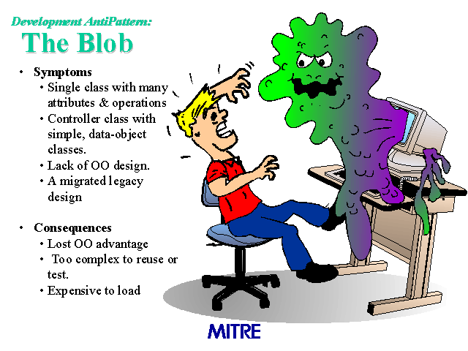

Slide 58
Criticism
The concept of design patterns has been criticized by some in the field of computer science.
Targets the wrong problem
Lacks formal foundations
Leads to inefficient solutions
Does not differ significantly from other abstractions

Slide 59
Conclusions
Design patterns make it easier to reuse successful designs and architectures. It’s important for every developer to be aware of design patterns but it’s also essential to know how and when to use them. Implementing the right patterns intelligently can be worth the effort but the opposite is also true. A badly implementing pattern can’t yield little benefit to a project. Also bear in mind that it’s not the number of patterns you implement that’s important but how you choose to implement them. For example, don’t choose a pattern just for the sake of using ‘one’ but rather try understanding the pros and cons of what particular patterns have to offer and make a judgment based on it’s fitness for your application.

Slide 60


Thank you
facebook.com/alokgo
@alokpandey01
Facebook
Twitter

